Slide 1
Somador Completo
Full Adder

Slide 2
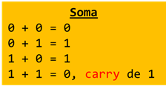
Somador Completo - Full Adder
 | Entradas 3 |  |  |  | Saídas |  | Expressão booleana Soma de produtos (SDP)
 |  |  |  | carry in | soma | Carry out
Pos. | A | B | A+B | Ci | S= Ci+(a+b) | Cout | S= A’.B’.Ci+A’.B.Ci’+A.B’.Ci’+A.B.Ci Cout= A’.B.Ci+A.B’.Ci+A.B.Ci’+A.B.Ci
0 | 0 | 0 | 0 | 0 | 0 | 0
1 | 0 | 0 | 0 | 1 | 1 | 0
2 | 0 | 1 | 1 | 0 | 1 | 0
3 | 0 | 1 | 1 | 1 | 0 | 1
4 | 1 | 0 | 1 | 0 | 1 | 0
5 | 1 | 0 | 1 | 1 | 0 | 1
6 | 1 | 1 | 0 | 0 | 0 | 1
7 | 1 | 1 | 0 | 1 | 1 | 1

Slide 3
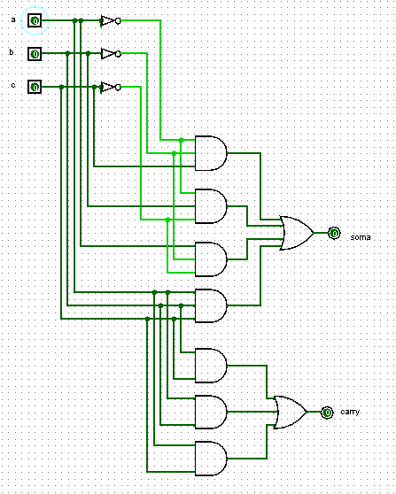
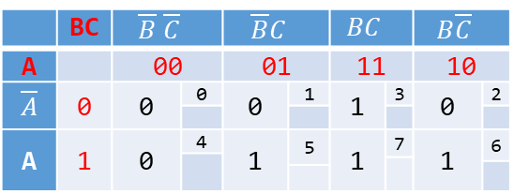
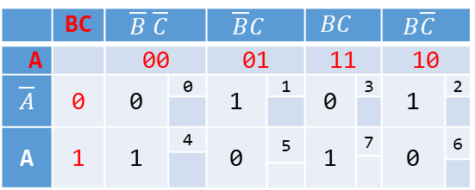
Somador Completo - Full Adder
 | BC | $$\overline{B} \overline{C}$$ |  | $$\overline{B}C$$ |  | $$BC$$ |  | $$B\overline{C}$$
A |  | 00 |  | 01 |  | 11 |  | 10
$$\overline{A}$$ | 0 | 0 | 0 | 1 | 1 | 0 | 3 | 1 | 2
A | 1 | 1 | 4 | 0 | 5 | 1 | 7 | 0 | 6
S= A’.B’.Ci+A’.B.Ci’+A.B’.Ci’+A.B.Ci
 | BC | $$\overline{B} \overline{C}$$ |  | $$\overline{B}C$$ |  | $$BC$$ |  | $$B\overline{C}$$
A |  | 00 |  | 01 |  | 11 |  | 10
$$\overline{A}$$ | 0 | 0 | 0 | 0 | 1 | 1 | 3 | 0 | 2
A | 1 | 0 | 4 | 1 | 5 | 1 | 7 | 1 | 6
Cout= BC+ab+ac

